Slide 1

Tempus Fugit: Process Improvement Through Time Management
Ben Dieck
MBC 638 – Data Analysis for Decision Making
Syracuse University

Slide 2
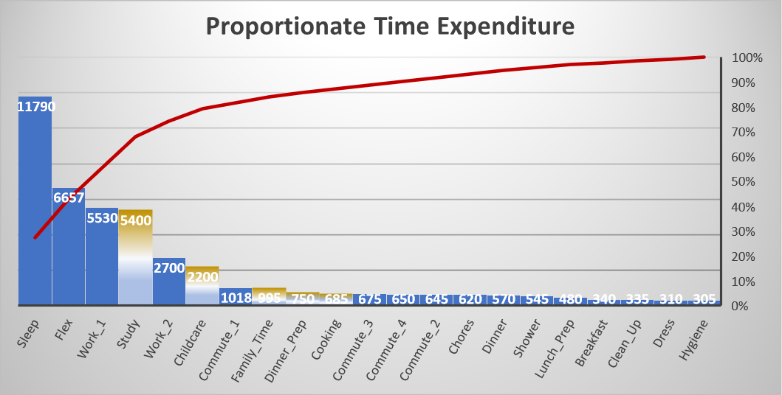
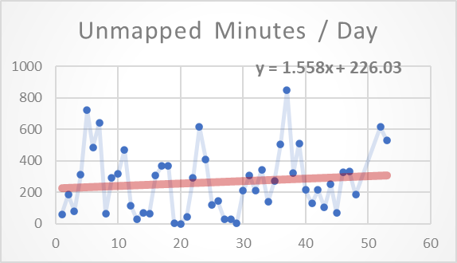
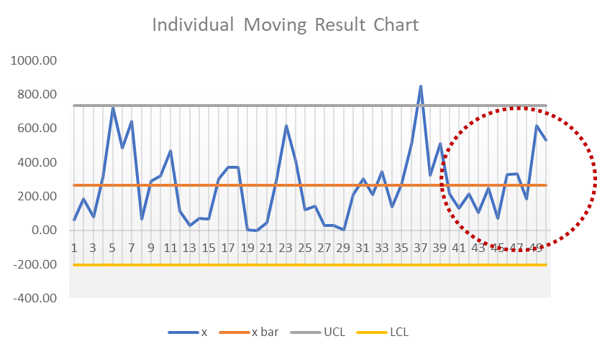
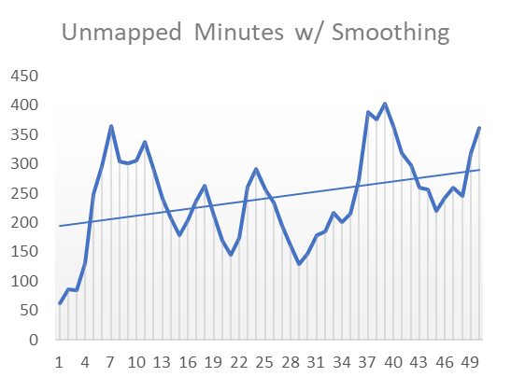
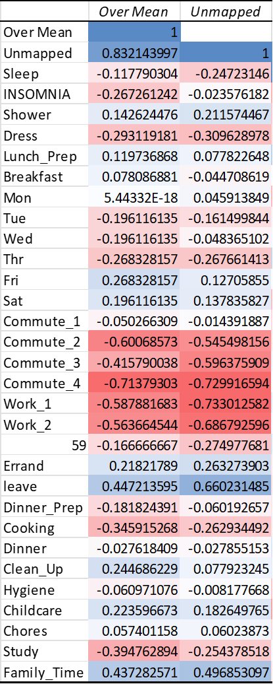
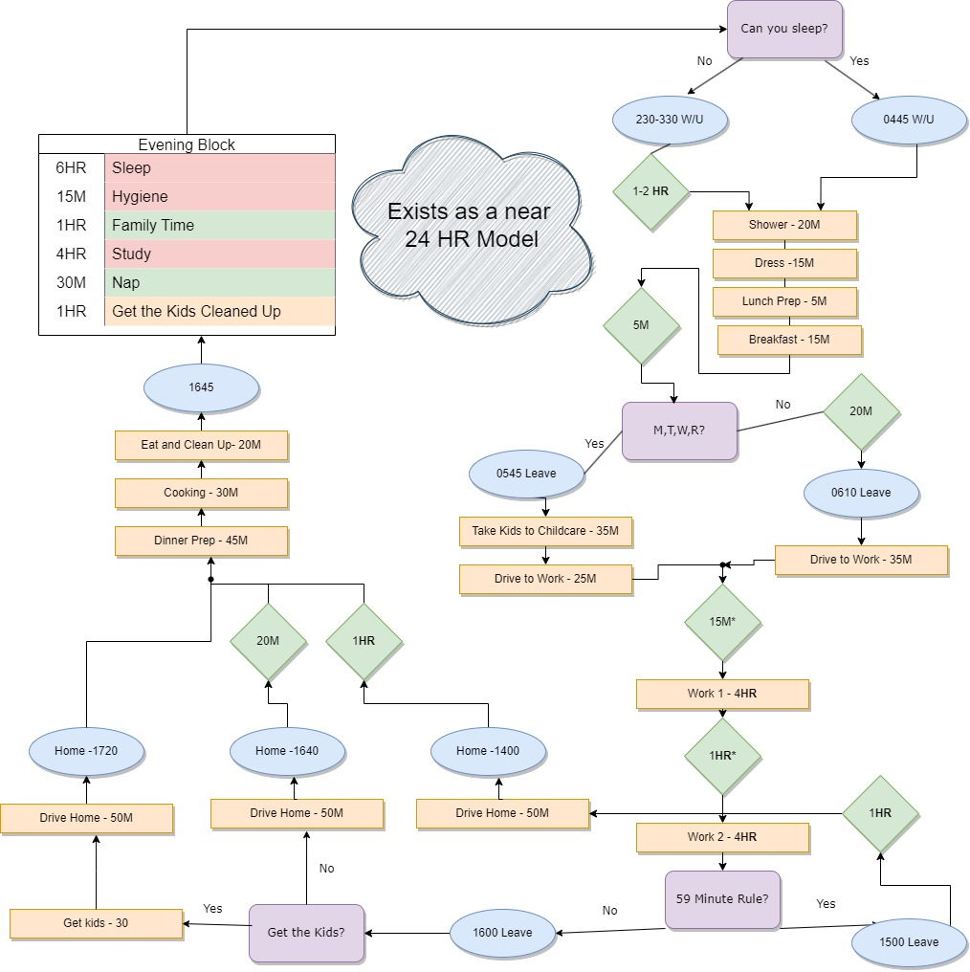
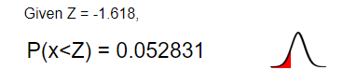
MBC638: Process Improvement, Flex Time, B. Dieck
Define: 11OCT2023
Measure:
11OCT-17NOV
Analyze:
19NOV-21NOV
Improve:
22NOV – 8DEC
Control:
9DEC – 13 DEC
How can we maximize the availability of intervals of unallotted time of 2 hours or more?
The culmination of full time employment, a masters, a family, and running a micro farm forces the scheduling and mapping of time throughout the day into a process model that creates a grind.
In order to deal with emerging requirements, and deviations in any of the current time requirements, there needs to be an increase in the availability of free time.
Business Impact: Failure in any of these sectors generates a loss of current quality of life. But failure in pursuing a masters loses an opportunity of $180,510.60 across the five-year window
Data collected on 29 variables over time:
Collected continuous data in minutes for events that take up time over the course of the day. Additionally collected categorical, discreet, data on day of the week and things like whether or not vacation time was put in.
Additional research may be required as the time period did not allow for a mathematically sound amount of data points.
Study and Cooking:
Initial analysis found that the majority of time, that had the ability to be influenced was being spent either studying, or cooking. Or in a task associated with cooking.
Correlations were found between how much flex time was available and how much time was spent on cooking tasks. Also there was a strong correlation with how much time was spent studying, but also a high variance in the time spent studying.
Applied Controls:
Applied controls into the process such as a regular interval of study per day instead of a fluctuating study period. Discontinued study at the conclusion of the interval. Also began to pre-prep meals on Sundays for the week.
Distinct signs of improvement seen in an upward trend of flex time per day after controls installed.
Hypothesis testing failed to indicate certain improvement.
Maintain Control:
IMR Control Charting indicates that post improvement process breaks the upper control limit, trends to hover closer to the mean overall, and may show indications of a pattern at the end of the collection period.
Additional sampling is required to ensure improvement to the process. However current measures indicate 172% increased yield in days with at least a 2 hour period of unallocated time over the previous process.
Greater correlations for cooking related tasks.
Install Control
Possible pattern emerging
SQL: 1.6
New Process
SQL: 2.8

Slide 3

Define: Find 2 Hours
The original process is time / task constrictive and does not allow for flexibility to handle life events.
Primary Time Sinks
Work
Family Care
Master’s Program
Increasing the availability of flexible time to handle chores, family care, or just health is essential to making it through the remaining months of this Master’s Program, when the schedule will slow down.
Generally, it takes two hours to get anything accomplished (including potential travel into town, set up, and clean up).
The system will work better to maximize the availability of 2 hour blocks of “Flex Time”.

Slide 4

Problem:
How can we maximize the availability of intervals of unallotted time of 2 hours or more?

Slide 5
Measure: Data Collection Plan
Data collection was conducted on tasks throughout the day with the amount of time required for a given task recorded at the culmination of the task.
All time was measured in minutes
Original collection data contains both continuous and discreet data
Primary measure of interest is “Unmapped” minutes in the day, which for the sake of this study is continuous data.
Discreet data with Boolean or categorical inputs were assigned ‘dummy variables’ to allow mathematical operations
Measurement error would be most present by recording the information at the end of the day, and attempting to remember how long a task took
This was alleviated by keeping a notebook on hand and recording the data immediately after tasks were completed.
This procedure was followed uniformly throughout the collection.
Primary bias that may exist is that I was the person conducting the activity, and the measurement of the activity. It may have been more accurate to have someone tell me how long it took me to do these activities.

Slide 6
Sample Size
In order to maintain a confidence level of 95%, with a 30-minute margin of error, then we should be looking for 181 days of data.
Ideally this would be 181 before a control was applied, and 181 after the control was applied.
Due to time constraints this is not feasible. Instead we have 50 datapoints.
30 days of data before a control was applied.
20 days after the control was applied.

Slide 7
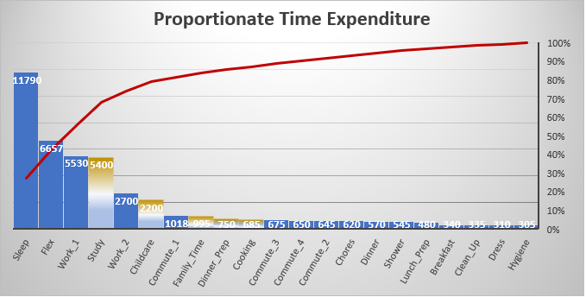
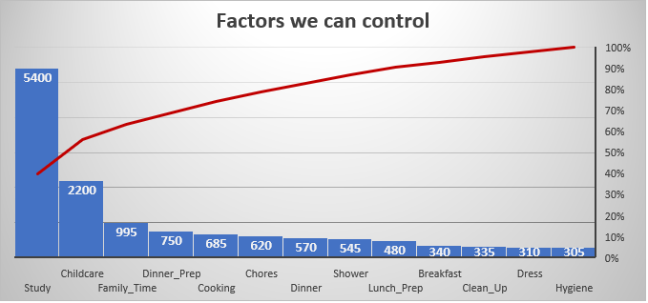
Analyze: Current Allocation
Majority of allocated time is, not surprisingly, given to Sleep, Work, and Study.
Once combined with current unallocated time, that takes up over 80% of the time within the dataset.
Factors like Sleep, Work, and Commute aren’t really within our control.
Although this makes a wonderful argument for telework.
Removing those factors from consideration we can potentially influence Study, Childcare, Family Time, and the tasks associated with preparing food. That takes us to the 80% line.
Other variables don’t really seem to take up enough time to merit consideration for a control.

Slide 8
Correlated Variables
A dummy variable was created to indicate categorical data points that trended above the mean of flex time, “Over Mean”.
Confirms several preconceptions of what we would see in the data.
Days where vacation days were used (leave) corresponded with higher than usual flex time.
Fridays and Saturdays, generally weekends, would also correspond with higher flex time.
Strongest negative correlations are with Commute_2 and Commute_4 which is indicative of days where I had to pick up the kids from daycare, which cuts an additional hour and change off my day.
Not all variables can be controlled.
Cooking, Family Time, and Study time all strongly correlated as being able to influence above average flex time and can be adjusted.

Slide 9

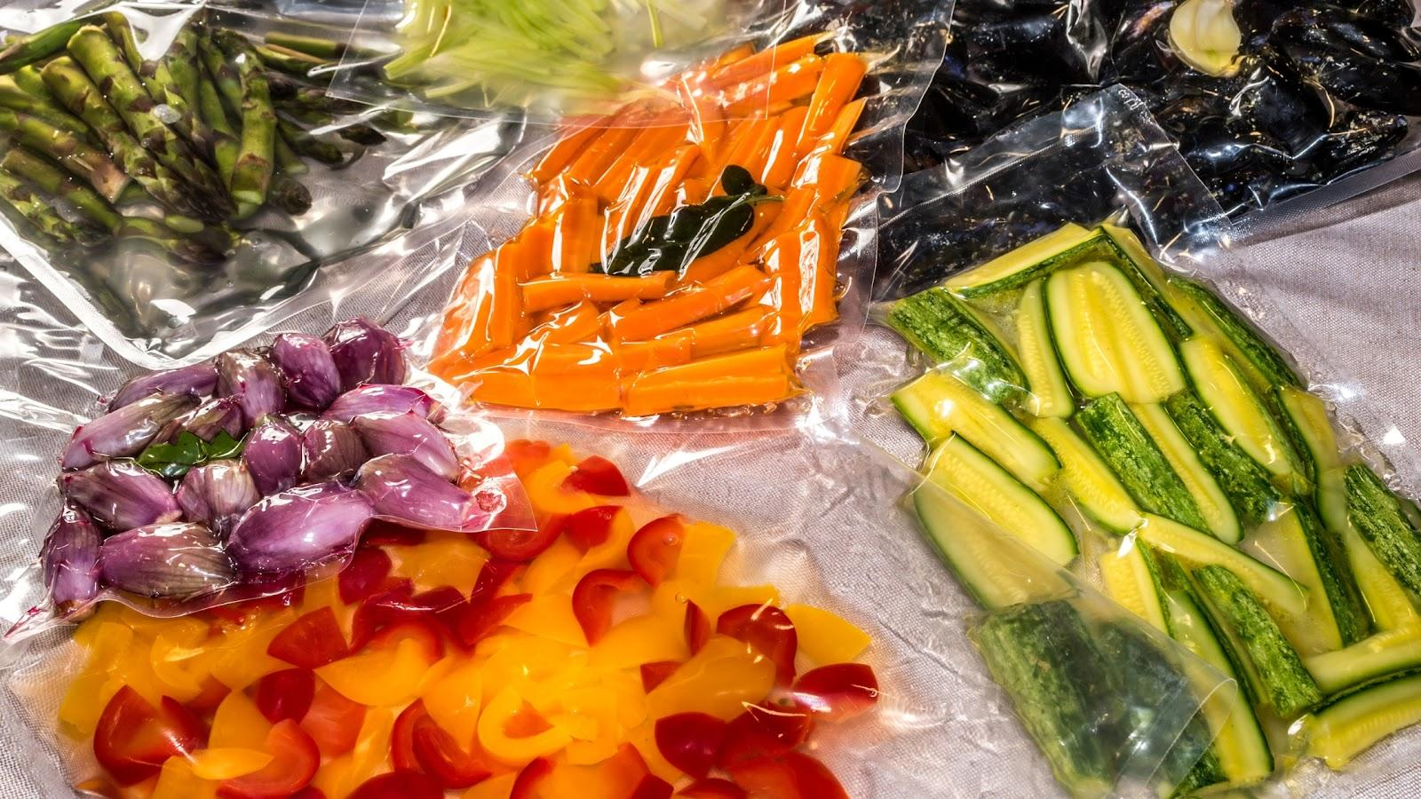

Improve
Study Time
Extremely high amounts of the week are devoted to study. This eats up the opportunity to accomplish other things.
Study time also seems to fluctuate irregularly depending on the day.
Changing study habits to a finite two hours a day will make it more regular, and stop late night study sessions which cut into a lot of flex time.
It isn’t as much reducing how much I work on school, but catching the hours and goals in the aggregate workload. And then stopping at a set point in the day to do other things.
Cooking
About 25% of available time that can be controlled is allotted for cooking related tasks.
There is strong correlation between cooking and above average flex time.
Creating more encompassing plans that shorten cooking and prep times will recover significant flex time at the end of the night.
This includes prepping recipes and ingredients so that they only need to be cooked instead of prepped. Bagging vegetables, marinating meats.
Family Time
Initial data also pointed out the contrast between time I work, and time spent with my family. I’m going to try to spend more time with them which may impact the data.

Slide 10
Control: Process Control
Using an IMR Process Control Chart there is little indication of meaningful change at first glance.
The Moving Range indicates that the process is in control, and defines the behavior of the Unmapped time variable.
One point breaks the upper control limit in the IMR chart, following the implementation of controls (Day 31).
The IMR does seem to have a bit of an upward trend towards the end of the time period.
Data points congregate at the mean line.
Flex time available tends not to be as close to the lower control limit as earlier datapoints.
The rhythmic up and down of the chart indicates that we have some obvious ‘seasonality’ with this data from weekend data that brings more flex time than the working week. .
Possible pattern emerging

Slide 11
Time Series
Time series repeats the depiction of seasonal data.
Utilizing data smoothing and a moving average we can model around the spikes caused by the weekends.
We begin to see more clearly that there is an upward trend in the amount of flex time available towards the end of time series.
After controls were installed.

Slide 12
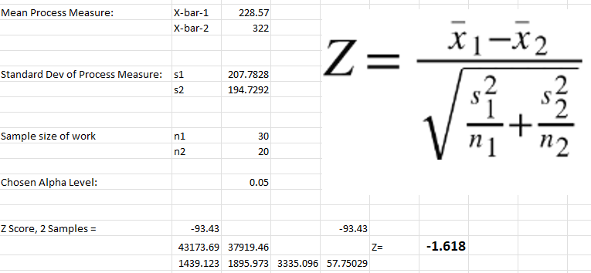
Hypothesis Test
Given a two sample hypothesis test there is a 5.2% chance that the new process could be explained by the old process.
This was calculated with a two sample hypothesis test for continuous data.
Strictly speaking, this fails the 95% confidence threshold, but barely. This is the only test that disproves the finding.

Slide 13
SQL: Measure of the Process
Data was assigned a categorical variable of whether it allowed for a block of 2 hours of unallocated flexible time within the day.
This was transformed into a dummy variable to perform functions
A given day, unit, had one possible defect: it didn’t have 2 hours of flex time.
Before controls were put in place, the day to day work / study process had an SQL of 1.6.
Only 53% of days allowed for 2 hours of unallocated time.
After controls were put in place, the time series that followed showed an SQL of 2.8.
93% of days had enough flex time to allocate to different tasks.
SQL: 1.6
New Process
SQL: 2.8

Slide 14

Continued Study
Data within this study contained significantly fewer datapoints than would be required to make a confident analysis. The study should be repeated / continued to contain the 181 data points required.
If the study is repeated, getting someone else to be the judge of when a task begins and ends would bring impartiality to the time.
If the controls hold true, then this is an effective improvement to the process and meets the desired KPIs.
Hold this model until completed with this Master’s Degree come April.
Then we’ll have all the free time we want.

